Slide 1
Lets Make Our Own! An Austrian Went Climbing 2nd Grade Version

Slide 2
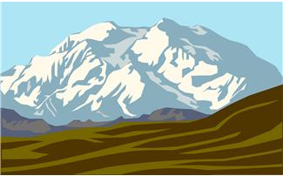
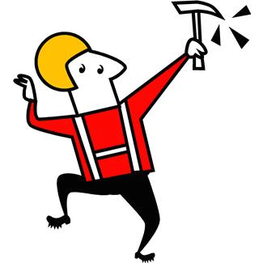
An Austrian went climbing on a mountain top high And as he was climbing this is what he would cry

Slide 3
Oh – Lee – Rah Oh Lee Rah Kah Kee Ah Oh Lee Rah Kah Koo (?) x3 Oh Lee Rah Kah Kee Ah Oh

Slide 4
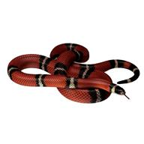
An Austrian went climbing on a mountain top high When along came a Snake interrupting his cry

Slide 5
Oh – Lee – Rah Oh Lee Rah Kah Kee Ah Oh Lee Rah Kah Koo (Hiss) x3 Oh Lee Rah Kah Kee Ah Oh

Slide 6
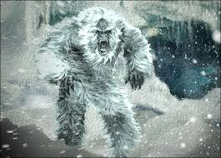
An Austrian went climbing on a mountain top high When along came a yeti interrupting his cry

Slide 7
Oh – Lee – Rah Oh Lee Rah Kah Kee Ah Oh Lee Rah Kah Koo (Hiss, Roar) x3 Oh Lee Rah Kah Kee Ah Oh

Slide 8
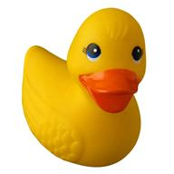
An Austrian went climbing on a mountain top high When along came a Duck interrupting his cry

Slide 9
Oh – Lee – Rah Oh Lee Rah Kah Kee Ah Oh Lee Rah Kah Koo (Hiss, Roar, Quack) x3 Oh Lee Rah Kah Kee Ah Oh

Slide 10
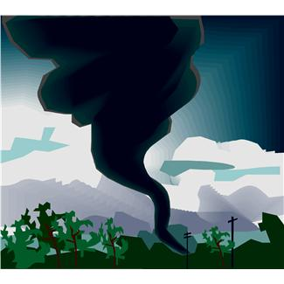
An Austrian went climbing on a mountain top high When along came a Tornado interrupting his cry

Slide 11
Oh – Lee – Rah Oh Lee Rah Kah Kee Ah Oh Lee Rah Kah Koo (Hiss, Roar, Quack, Swish) x3 Oh Lee Rah Kah Kee Ah Oh

Slide 12
An Austrian went climbing on a mountain top high When along came a Owl interrupting his cry

Slide 13
Oh – Lee – Rah Oh Lee Rah Kah Kee Ah Oh Lee Rah Kah Koo (Hiss, Roar, Quack, Swish, WhooWhoo) x3 Oh Lee Rah Kah Kee Ah Oh

