Slide 1
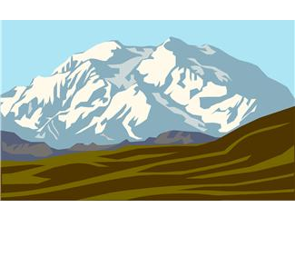
An Austrian Went Climbing

Slide 2
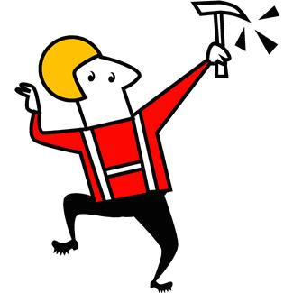
An Austrian went climbing on a mountain top high And As he was climbing this is what he’d cry.

Slide 3
Oh – Lee – Rah Oh Lee Rah Kah Kee Ah Oh Lee Rah Kah Koo Oh Lee Rah Kah Kee Ah Oh Lee Rah Kah Koo Oh Lee Rah Kah Kee Ah Oh Lee Rah Kah Koo Oh Lee Rah Kah Kee Ah Oh

Slide 4
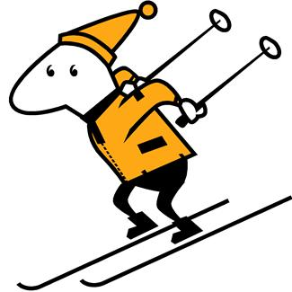
An Austrian went climbing on a mountain top high When along came a Skier interrupting his cry

Slide 5
Oh – Lee – Rah Oh Lee Rah Kah Kee Ah Oh Lee Rah Kah Koo (Swoosh) Oh Lee Rah Kah Kee Ah Oh Lee Rcah Kah Koo (Swoosh) Oh Lee Rah Kah Kee Ah Oh Lee Rah Kah Koo (Swoosh) Oh Lee Rah Kah Kee Ah Oh

Slide 6
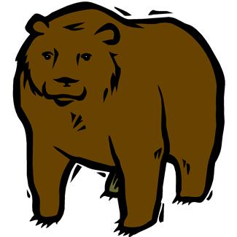
An Austrian went climbing on a mountain top high When along came a Grizzly Bear interrupting his cry

Slide 7
Oh – Lee – Rah Oh Lee Rah Kah Kee Ah Oh Lee Rah Kah Koo (Swoosh, Grrrr) x3 Oh Lee Rah Kah Kee Ah Oh

Slide 8
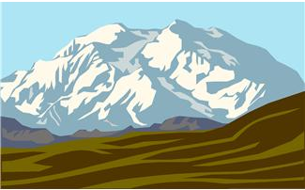
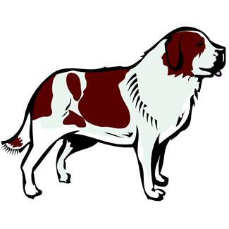
An Austrian went climbing on a mountain top high When along came a Saint Bernard interrupting his cry

Slide 9
Oh – Lee – Rah Oh Lee Rah Kah Kee Ah Oh Lee Rah Kah Koo (Swoosh, Grrrr, Woof) x3 Oh Lee Rah Kah Kee Ah Oh

Slide 10
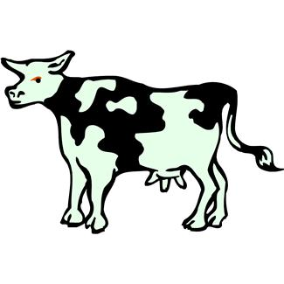
An Austrian went climbing on a mountain top high When along came a Milking Cow interrupting his cry

Slide 11
Oh – Lee – Rah Oh Lee Rah Kah Kee Ah Oh Lee Rah Kah Koo (Swoosh, Grrrr, Woof, Mooooo) x3 Oh Lee Rah Kah Kee Ah Oh

Slide 12
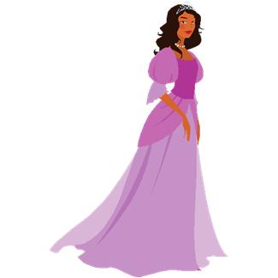
An Austrian went climbing on a mountain top high When along came a Lady Fair interrupting his cry

Slide 13
Oh – Lee – Rah Oh Lee Rah Kah Kee Ah Oh Lee Rah Kah Koo (Swoosh, Grrrr, Woof, Mooooo, Youuuu Whooo) x3 Oh Lee Rah Kah Kee Ah Oh

Slide 14
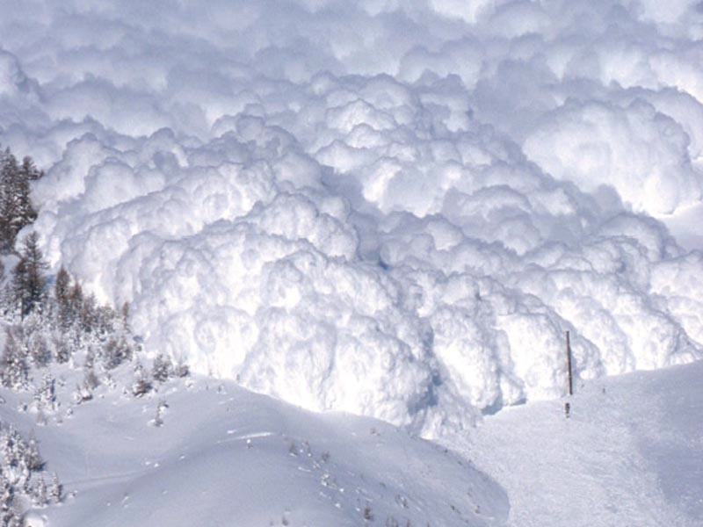
An Austrian went climbing on a mountain top high When along came an AVALANCHE AHHHHHHHHHHHH

